Slide 1

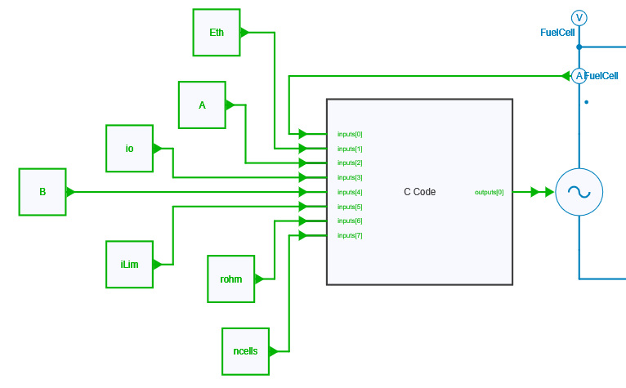
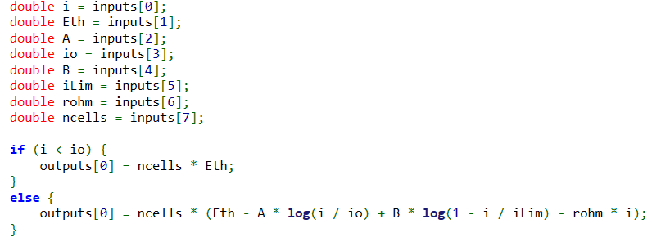
C-code block
Controlled voltage source

Slide 2
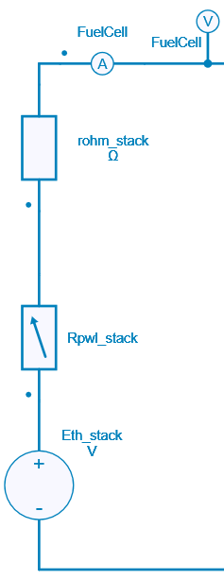
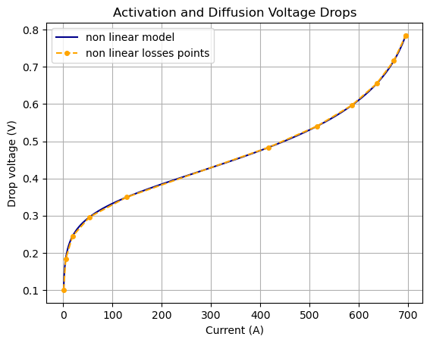

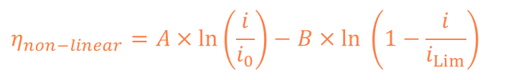
+
PWL Resistor
i
Ohmic losses
$$R_{ohm}$$
Diffusion losses
Modeling of non-linear losses in a single non-linear resistor
Activation losses
$$η_{non−linear}=A×\ln\left(\frac{i}{i_{0}}\right)−B×\ln\left(1−\frac{i}{i_{Lim}}\right)$$
-

Slide 3
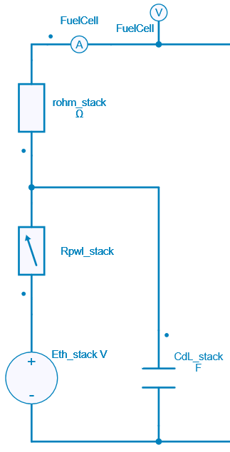


+
i
Ohmic losses
$$R_{ohm}$$
Diffusion losses
Activation losses
Double layer phenomena
$$C_{DL}$$
-

Slide 4
